Slide 1
Project Presentation on E-COMMERCE WEBSITE

Slide 2
INTRODUCTION Technologies used.
Front End
HTML
CSS
BOOTSTRAP
Middleware
J2EE
JAVA
Backend
H2 DATABASE
Other Technologies
APACHE TOMCAT SERVER
MVC DESIGN PATTERN
ECLIPSE IDE
SPRING
HIBERNATE
JUNIT

Slide 3
MODULES
USERS DETAILS
CATEGORY
SUPPLIER
PRODUCT
CART
SHIPPING

Slide 4
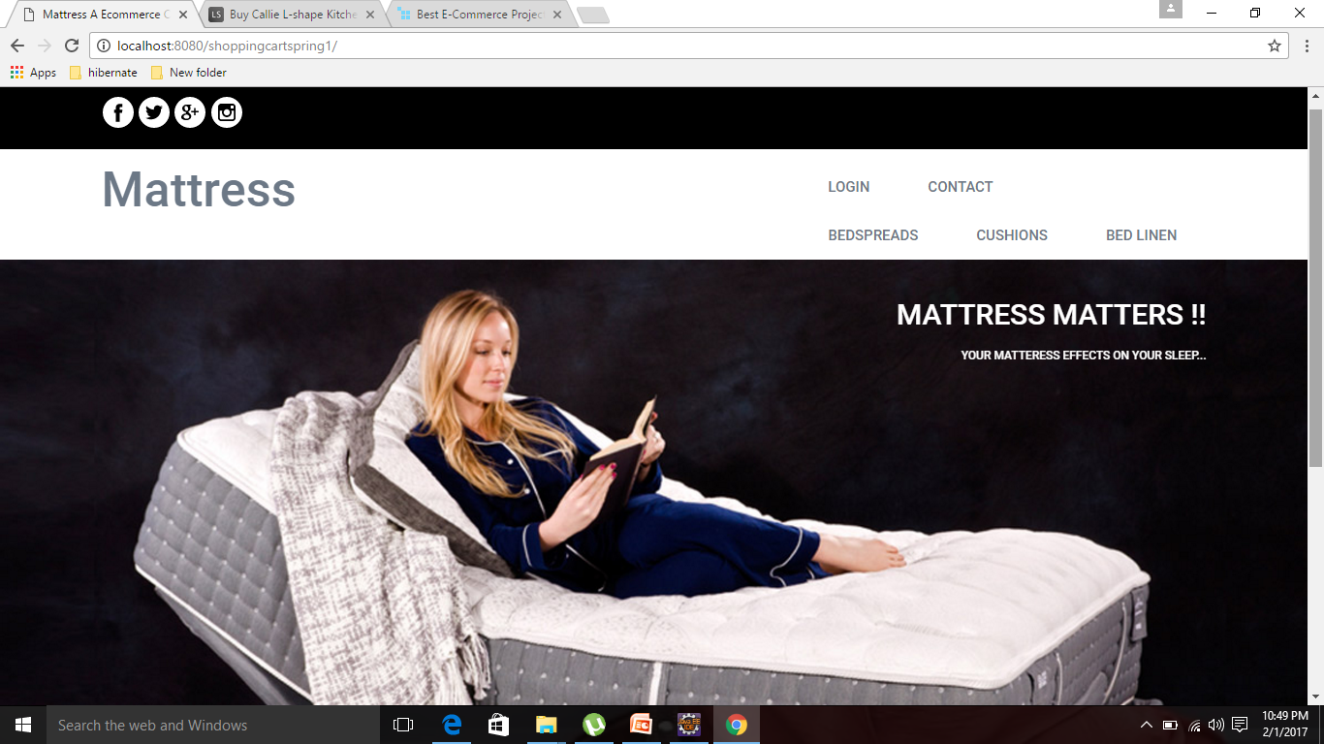
LANDING PAGE

Slide 5
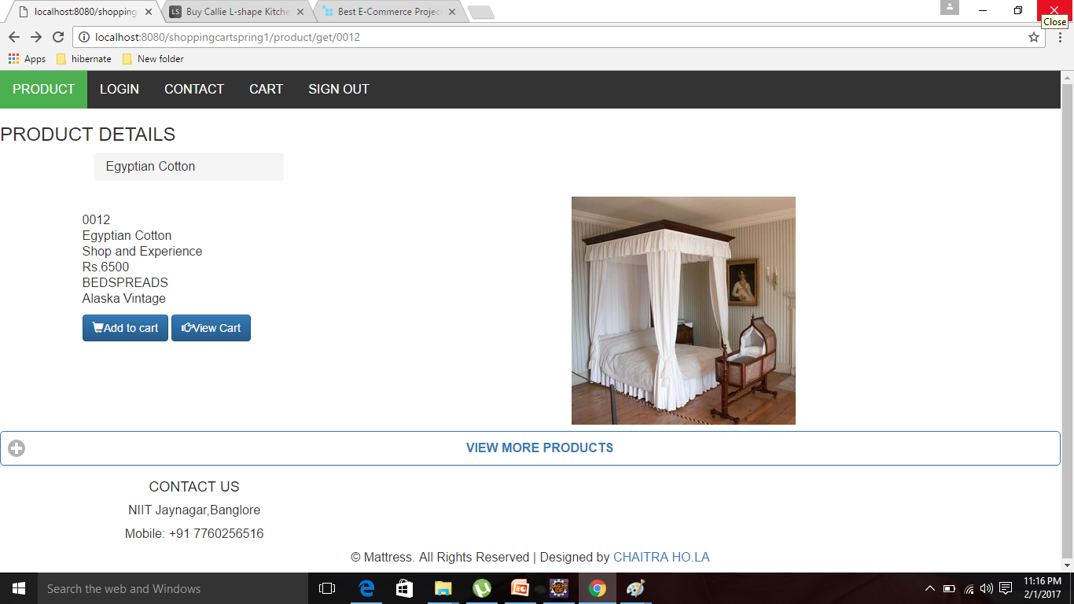
PRODUCT INFORMATION

Slide 6
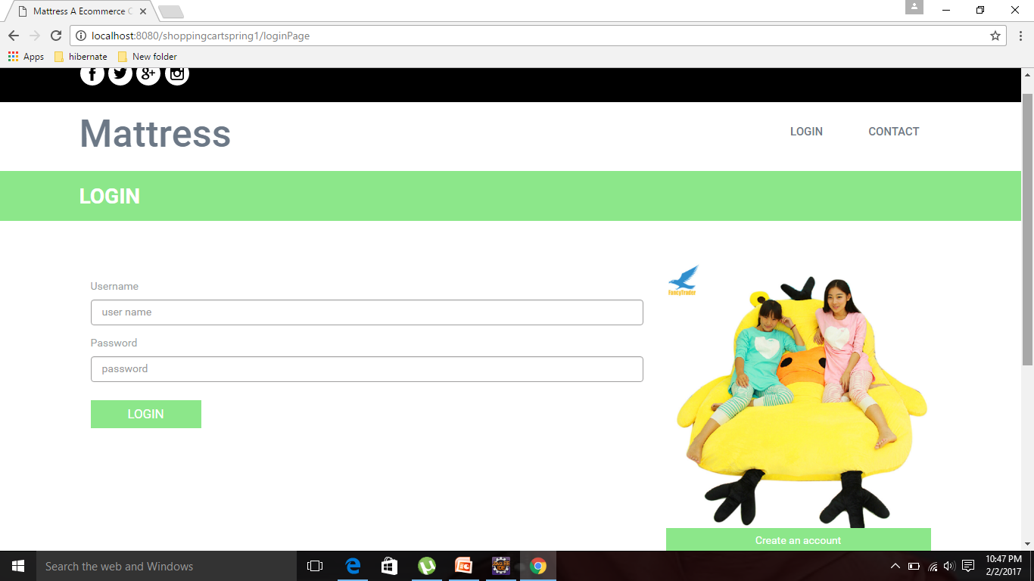
LOGIN

Slide 7
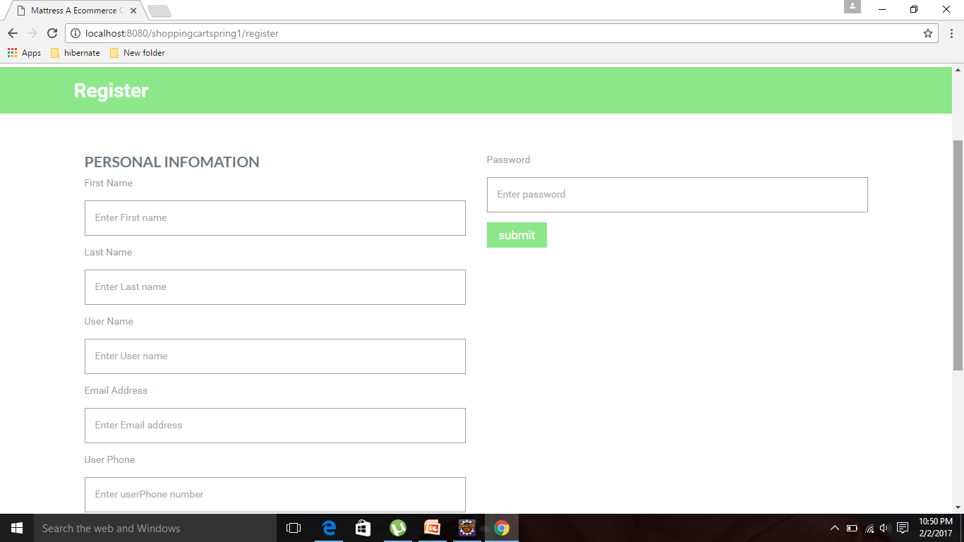
REGISTER

Slide 8
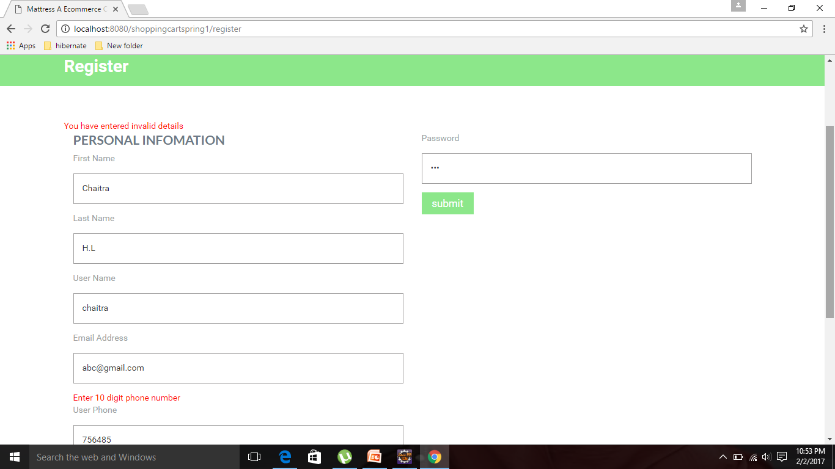
ERROR MESSAGES

Slide 9
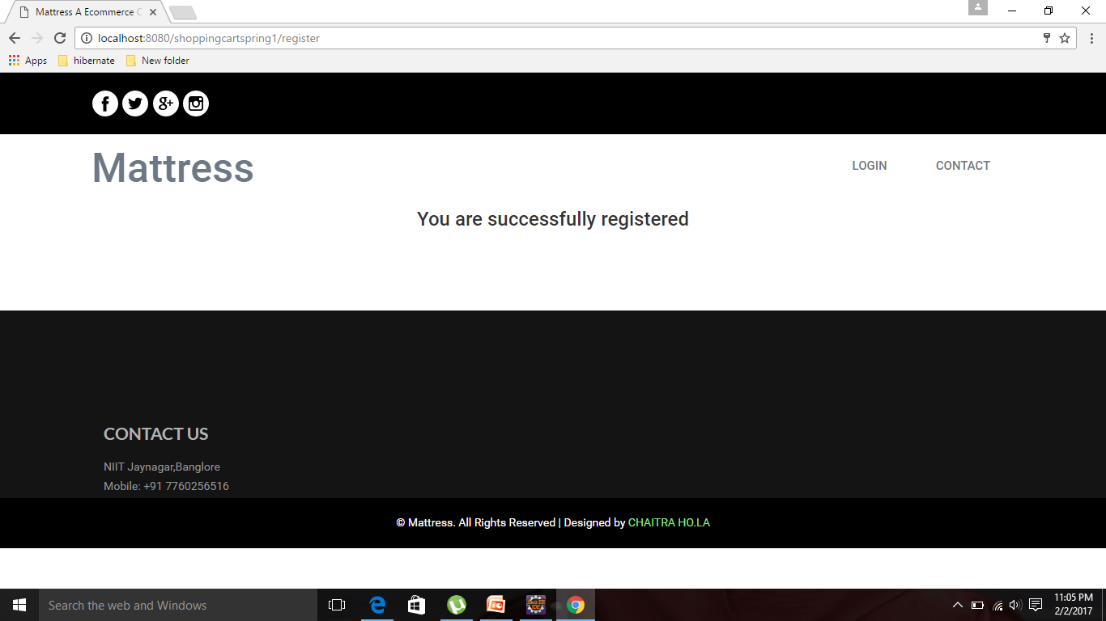
REGISTRATION SUCCESS

Slide 10
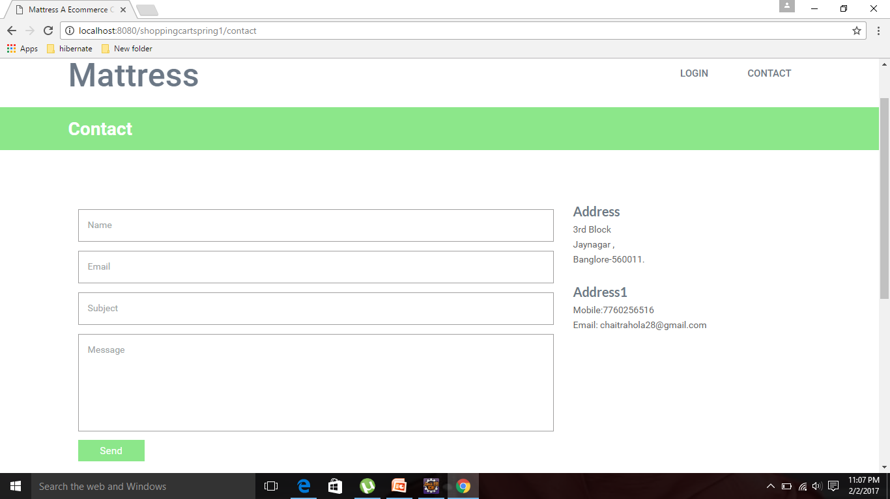
CONTACT

Slide 11
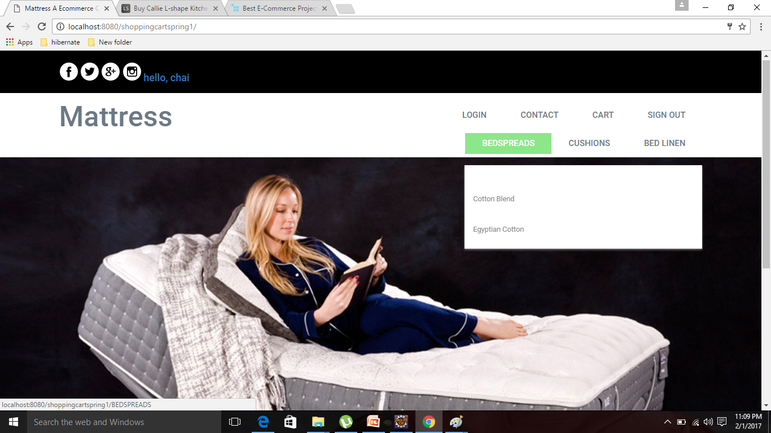
USER LOGIN

Slide 12
PRODUCT INFORMATION

Slide 13
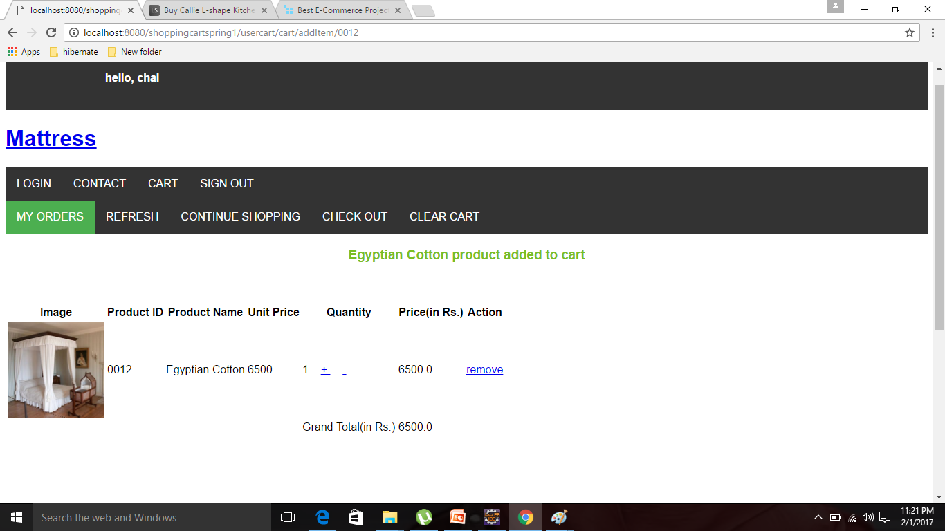
MY CART PAGE

Slide 14
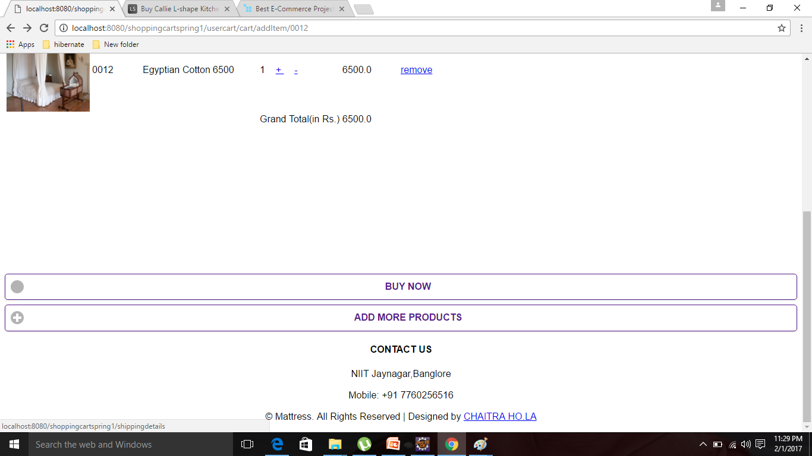

Slide 15
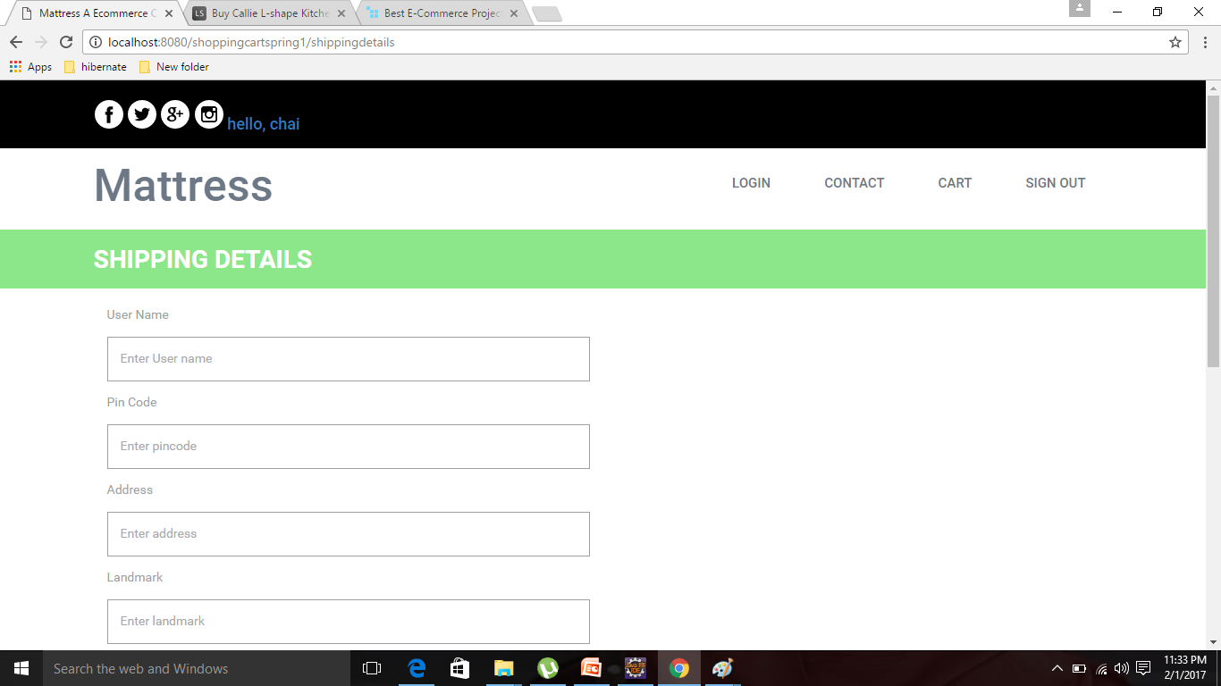
SHIPPING DETAILS

Slide 16
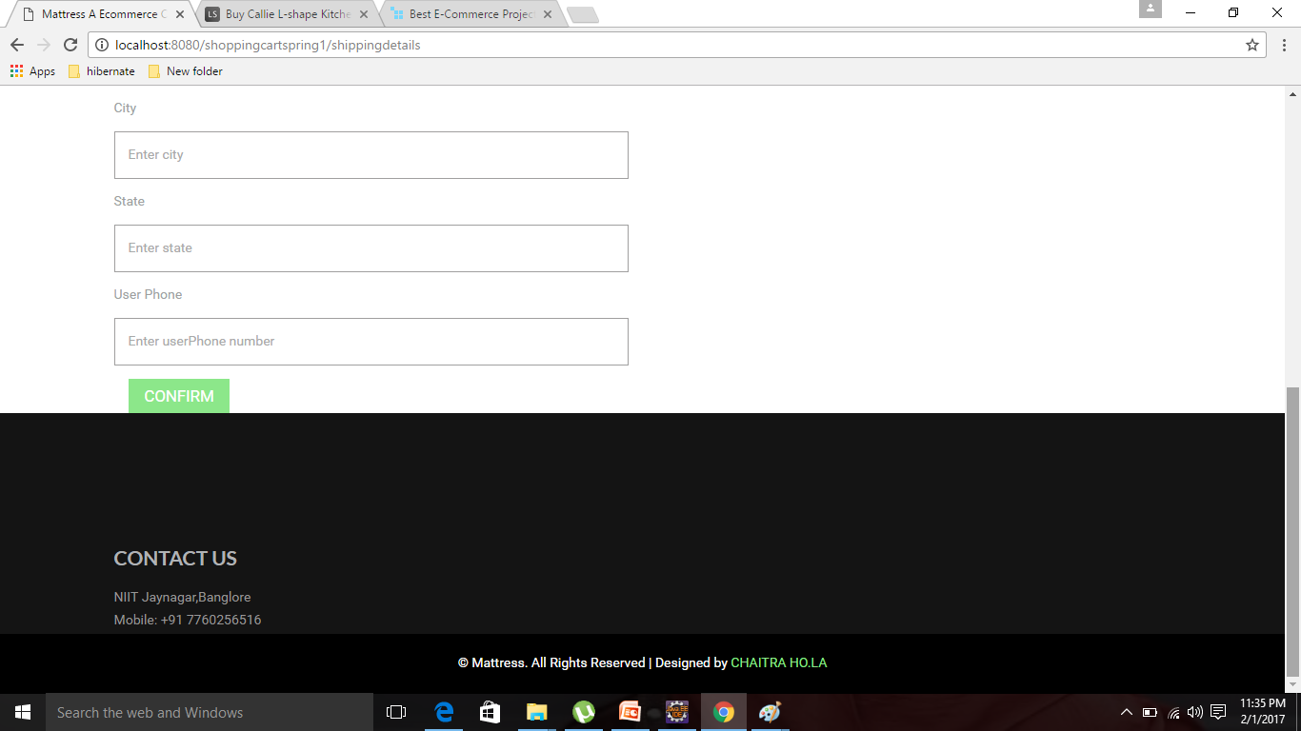

Slide 17
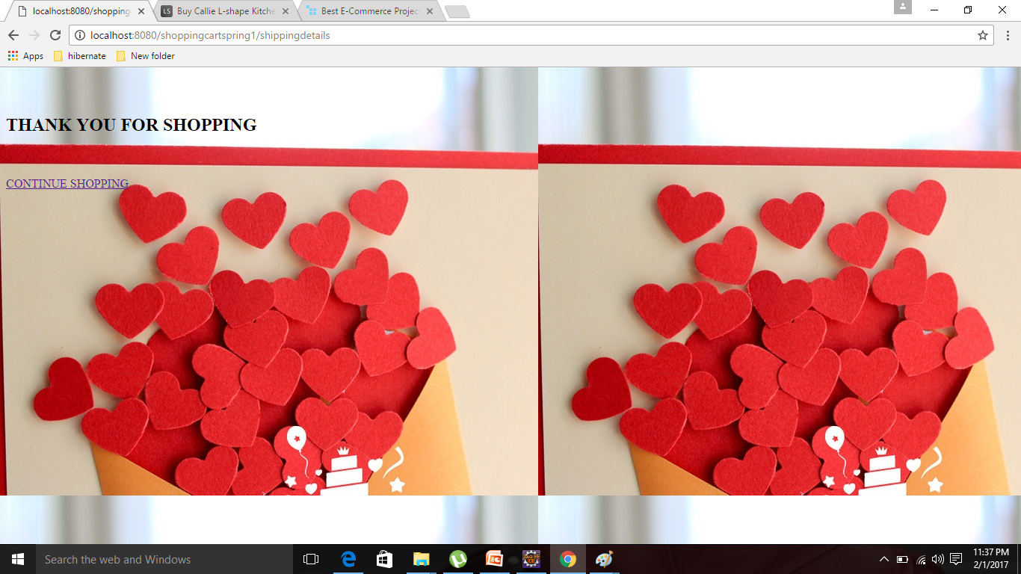
THANK YOU

Slide 18
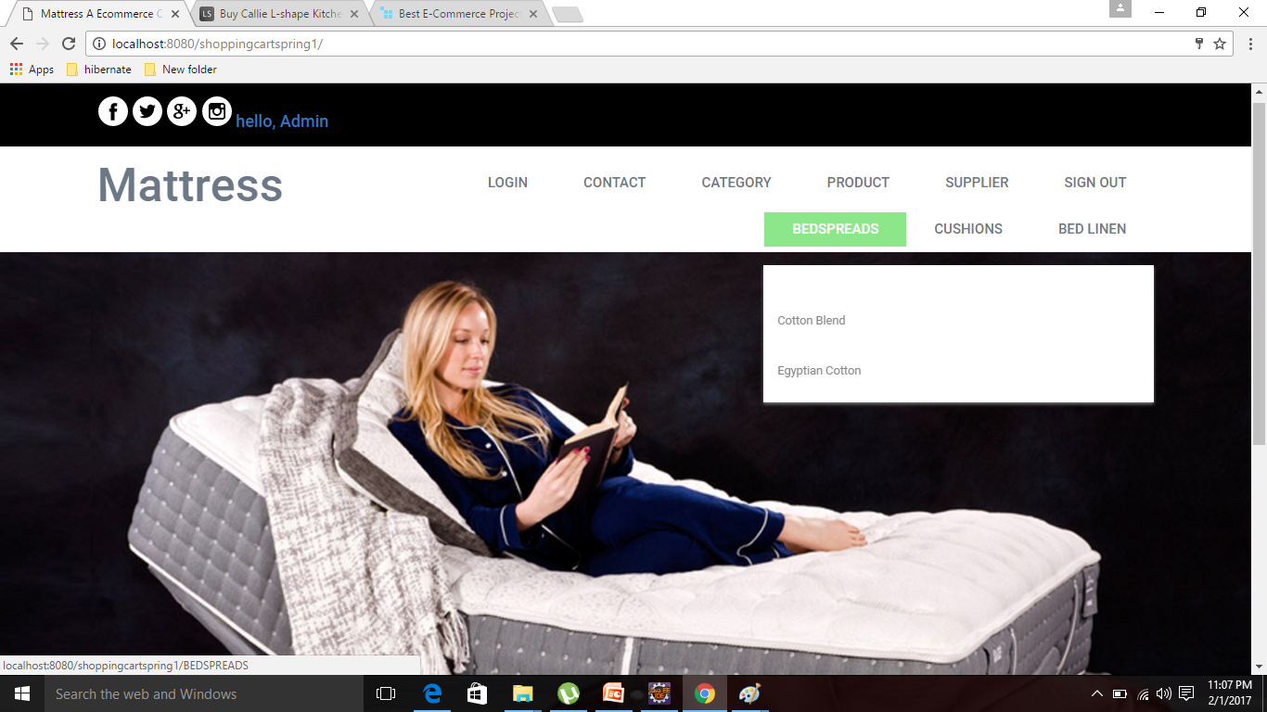
ADMIN LOGIN

Slide 19
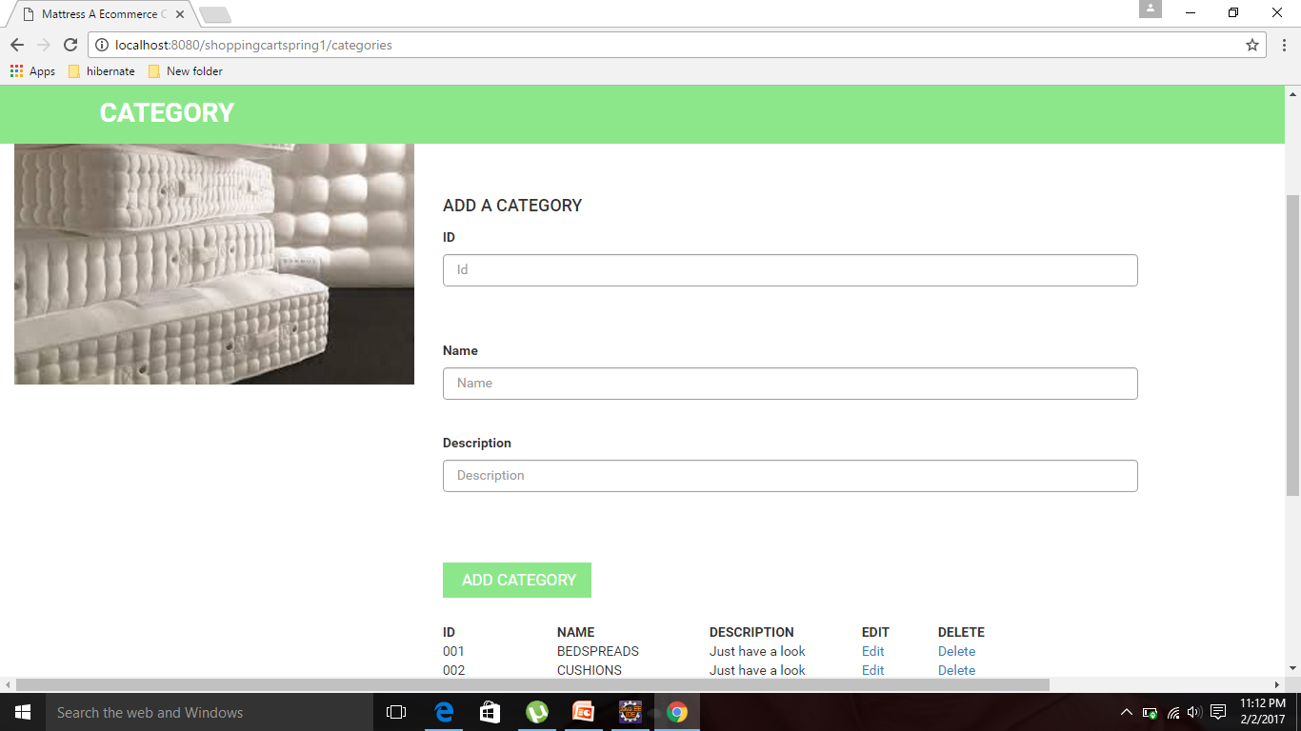
CATEGORY

Slide 20
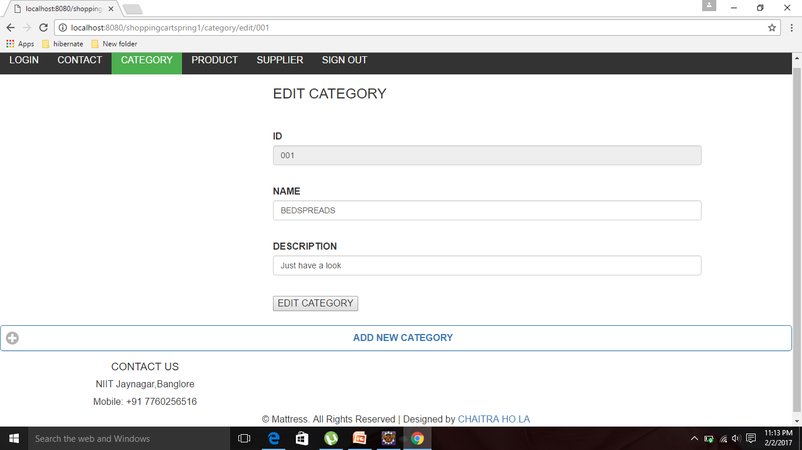
EDIT CATEGORY

Slide 21
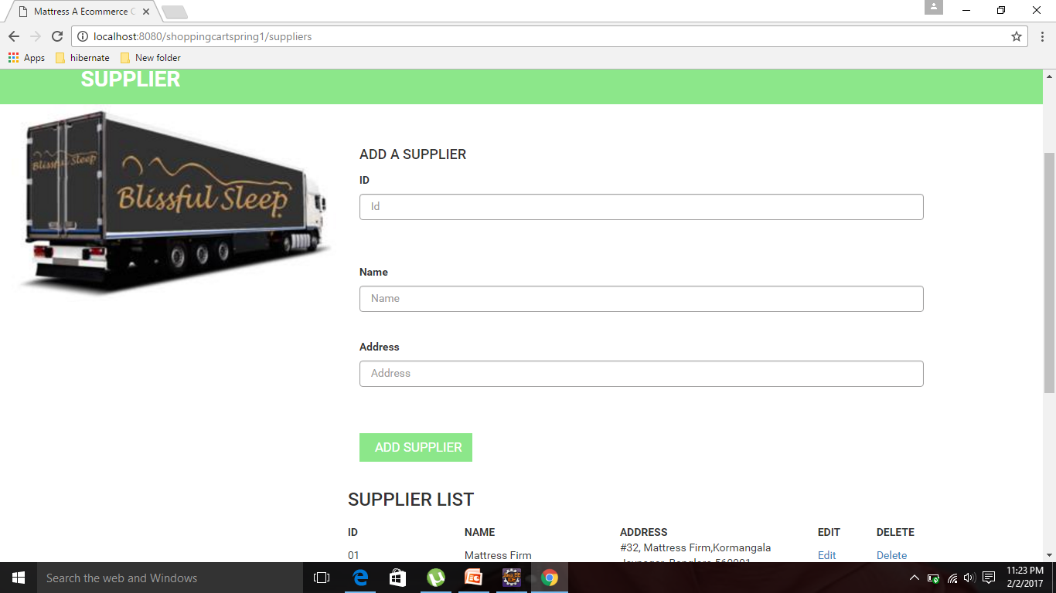
SUPPLIER

Slide 22
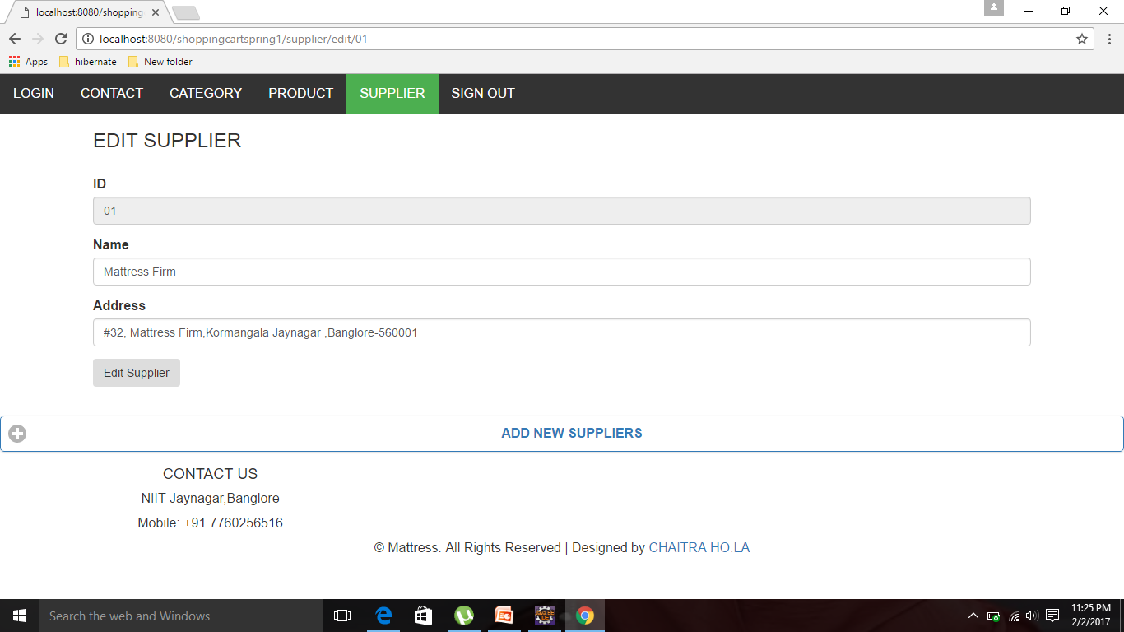
EDIT SUPPLIER

Slide 23
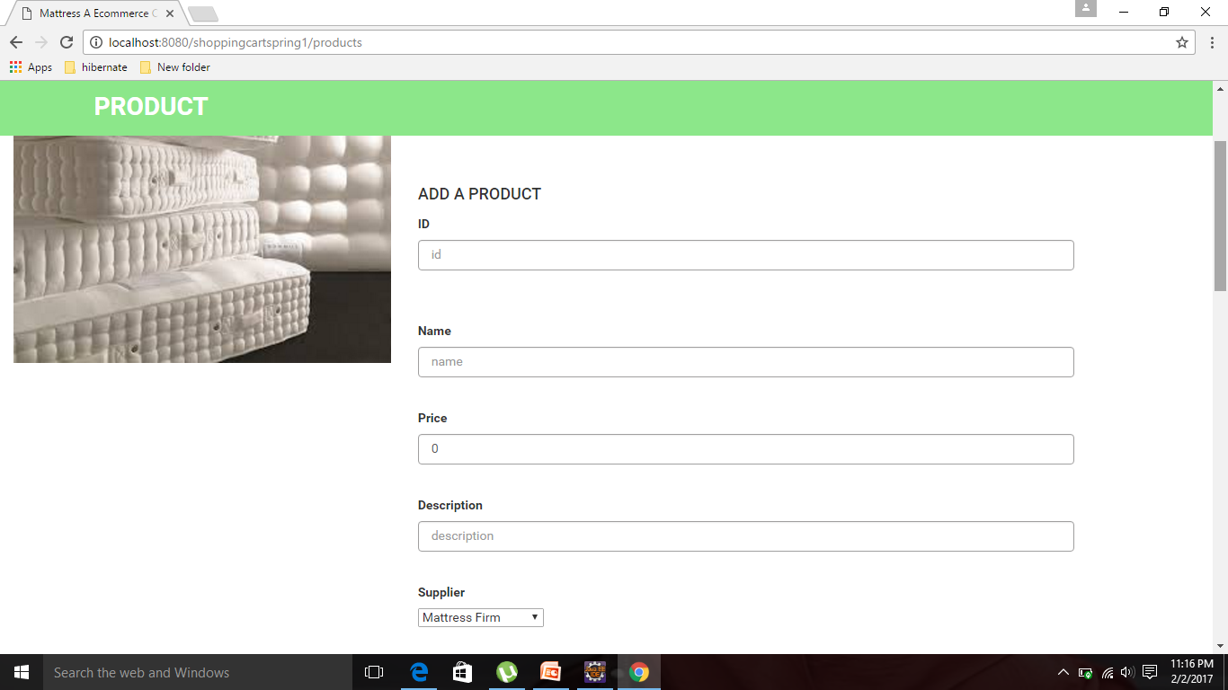
PRODUCT

Slide 24
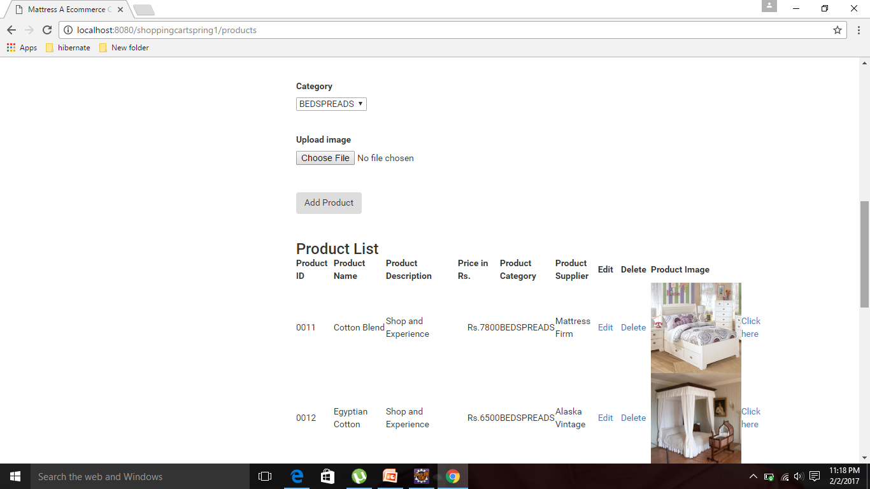

Slide 25
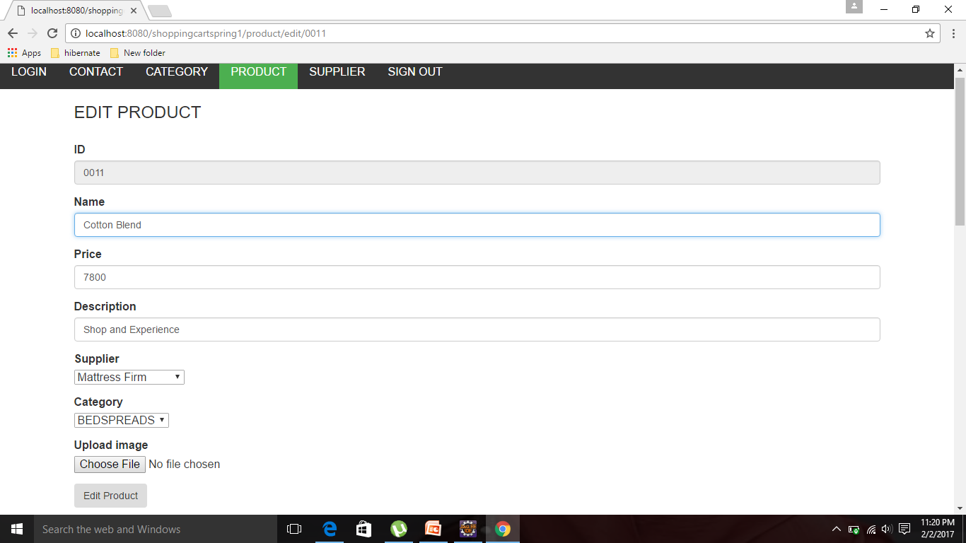
EDIT PRODUCT

Slide 26
Thank you

